Slide 1
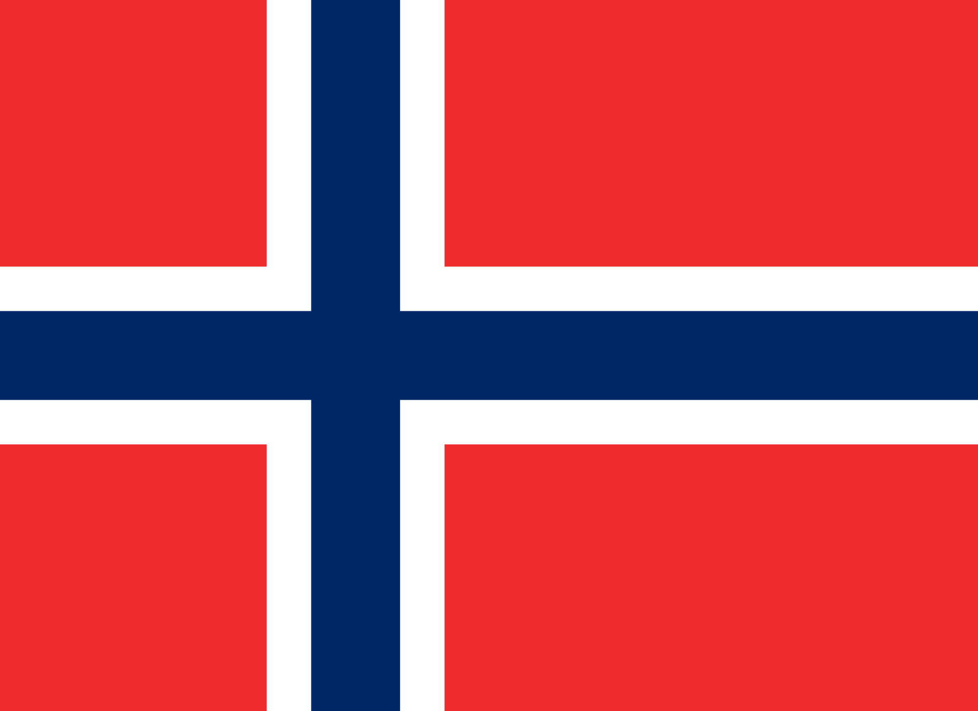
12 facts about Norway

Slide 2
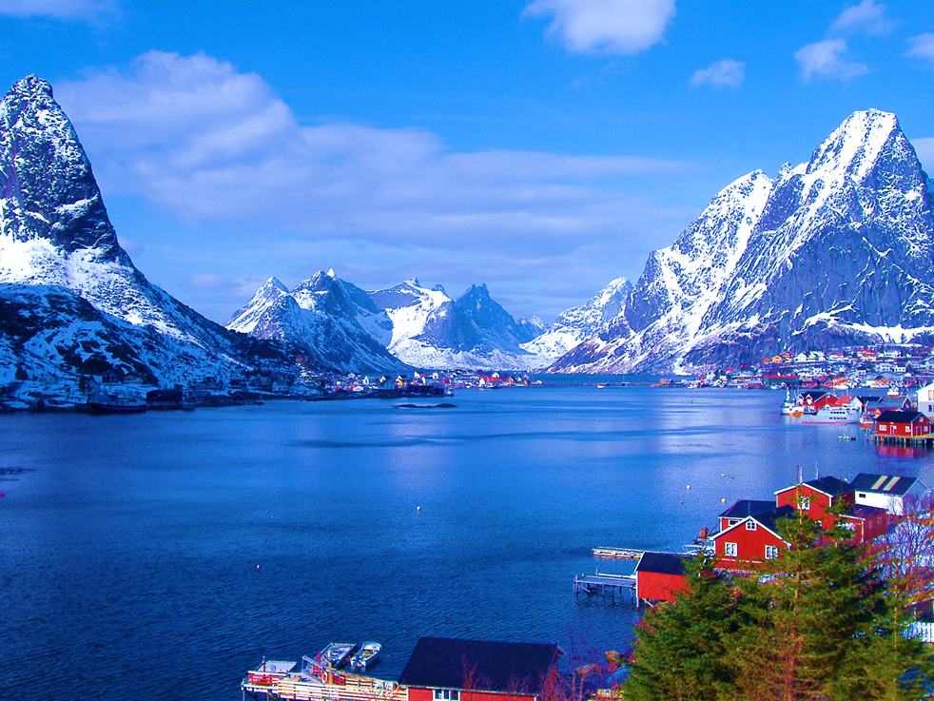
1-4
The Jostedalsbreen, in Norway, is the largest glacier in Northern Europe.
Norway has over 20,000 km of coastline.
Gas prices are among the highest in the world, even though Norway is one of the biggest exporters of oil in the world.
The Laerdal road tunnel is the world’s longest road tunnel at 24.5 km (15 miles)

Slide 3
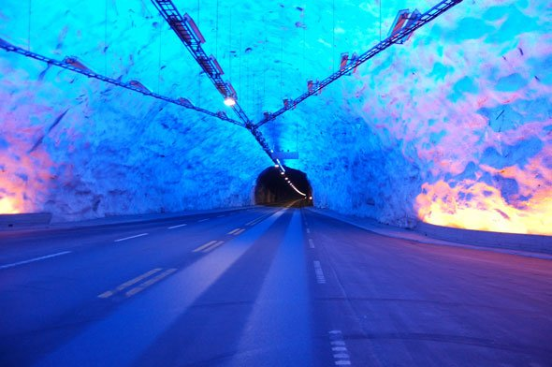
5-8
Norway also has the world’s deepest underwater tunnel at 287 meters deep.
It is the most peaceful country, according to the Global Peace Index.
The cheese slicer was invented in Norway.
Norway is the 6th largest country in Europe, but only ranks 28th as far as population.

Slide 4
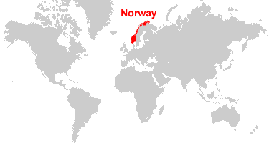
9-12
Food prices are so high in Norway that many people travel to Sweden to buy their groceries.
There are about 450,000 lakes in Norway.
There are as many Norwegian descendants living in the US as there are Norwegians living in Norway, especially the states of North Dakota, Minnesota and Wisconsin.

Slide 5
video
https://www.youtube.com/watch?v=ebqdwQzmSHM

