Slide 1
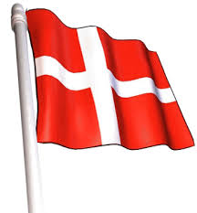
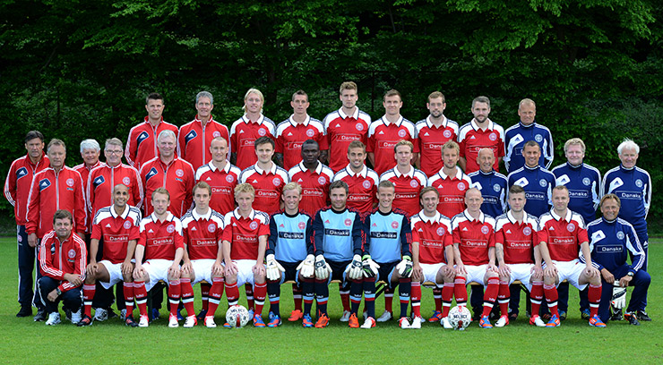
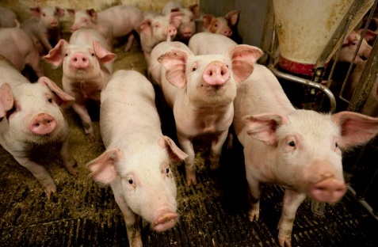
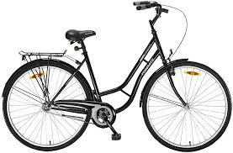
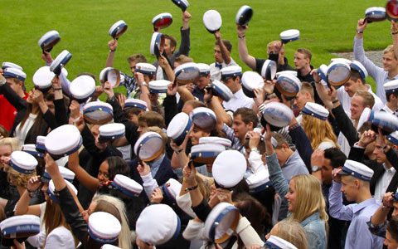
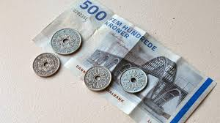
DENMARK
Fun facts about us Danes

Slide 2
“I Danmark er jeg født” “I am Born in Denmark
https://www.youtube.com/watch?v=mIh_ZGlyc3s

Slide 3
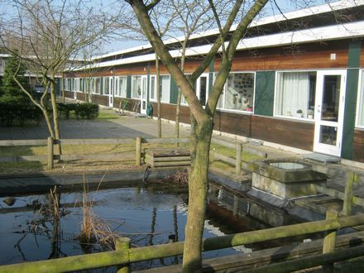
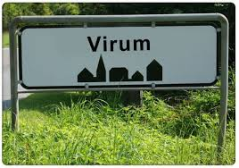
Virum and Borup

Slide 4
The Danish Royal Family
Yes or no?

Slide 5
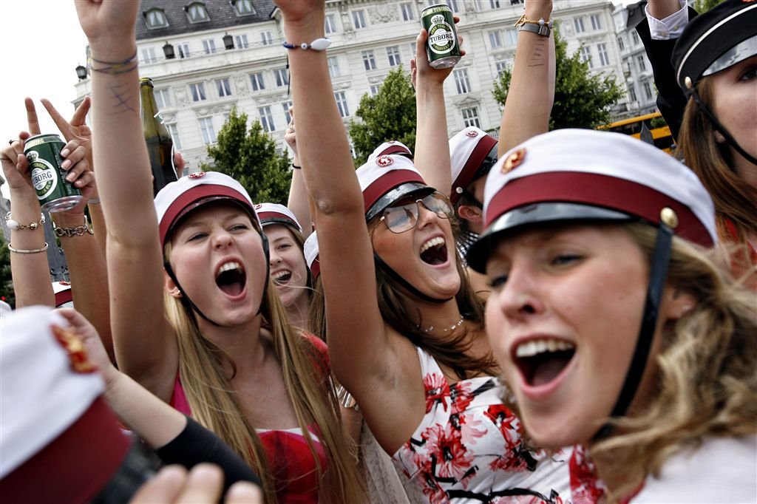
Free health care & free education

Slide 6
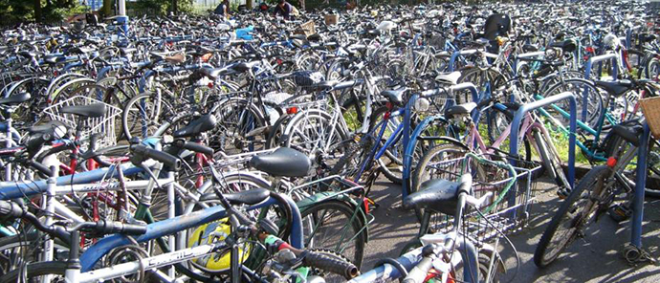
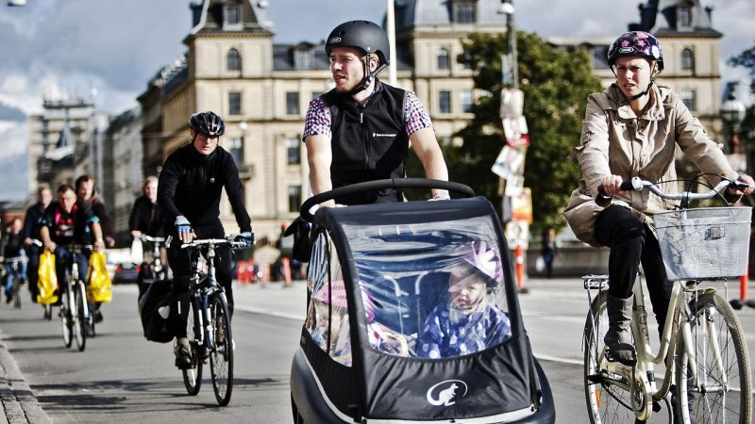
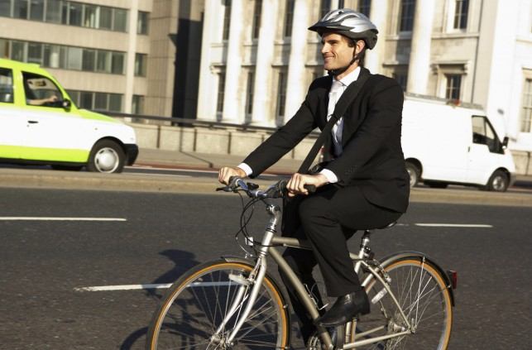
Bicycle Traffic
In Copenhagen, 50% of the people commute by bike everyday and there are more bikes than inhabitants.

Slide 7
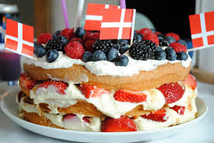
DANNEBROG

Slide 8
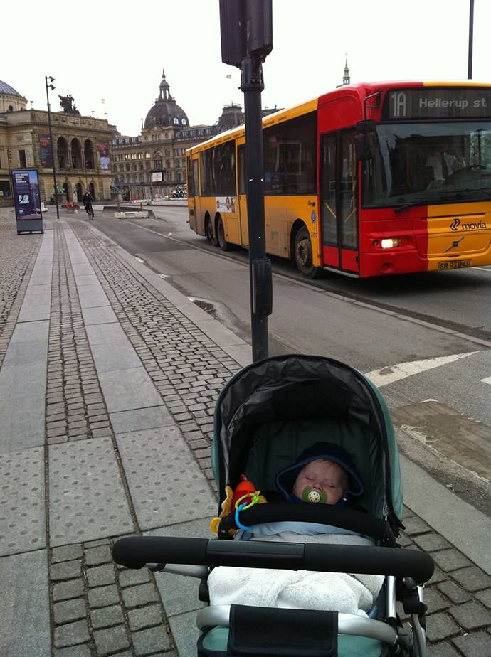
Babies
Whether it’s raining or snowing, the babies in Denmark can sleep outside, as long as they are wearing the right clothing.

